Slide 1
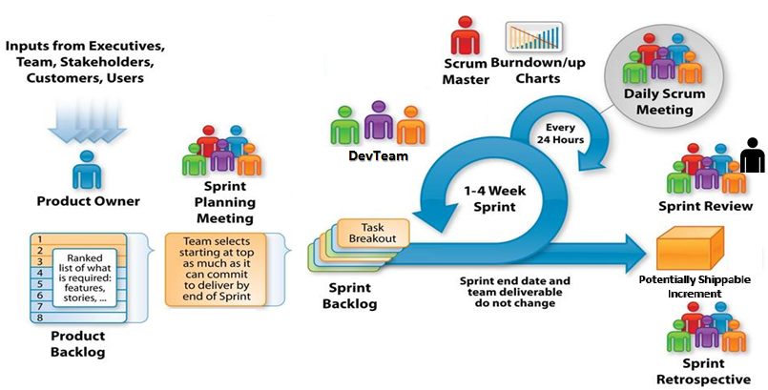

Scrum Mechanics
For Future Sprints
Adapted from: http://csharpcorner.mindcrackerinc.netdna-cdn.com/UploadFile/BlogImages/11292015063901AM/SystemsPlus-Scrum-Image-.jpg
Notes:
Speaker Notes
Discuss mechanics/process parts of Scrum framework
Roles
Product owner
Scrum Master
DevTeam
Artifacts
Product Backlog
Sprint Backlog
Potentially Shippable Increment
Ceremonies
Sprint Planning
Daily Standup
Sprint Review
Retrospective
Do not discuss mindset part of Scrum Framework

